Slide 1
Final
Project Presentation
Ryan Buchanan

Slide 2
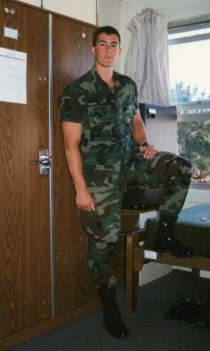
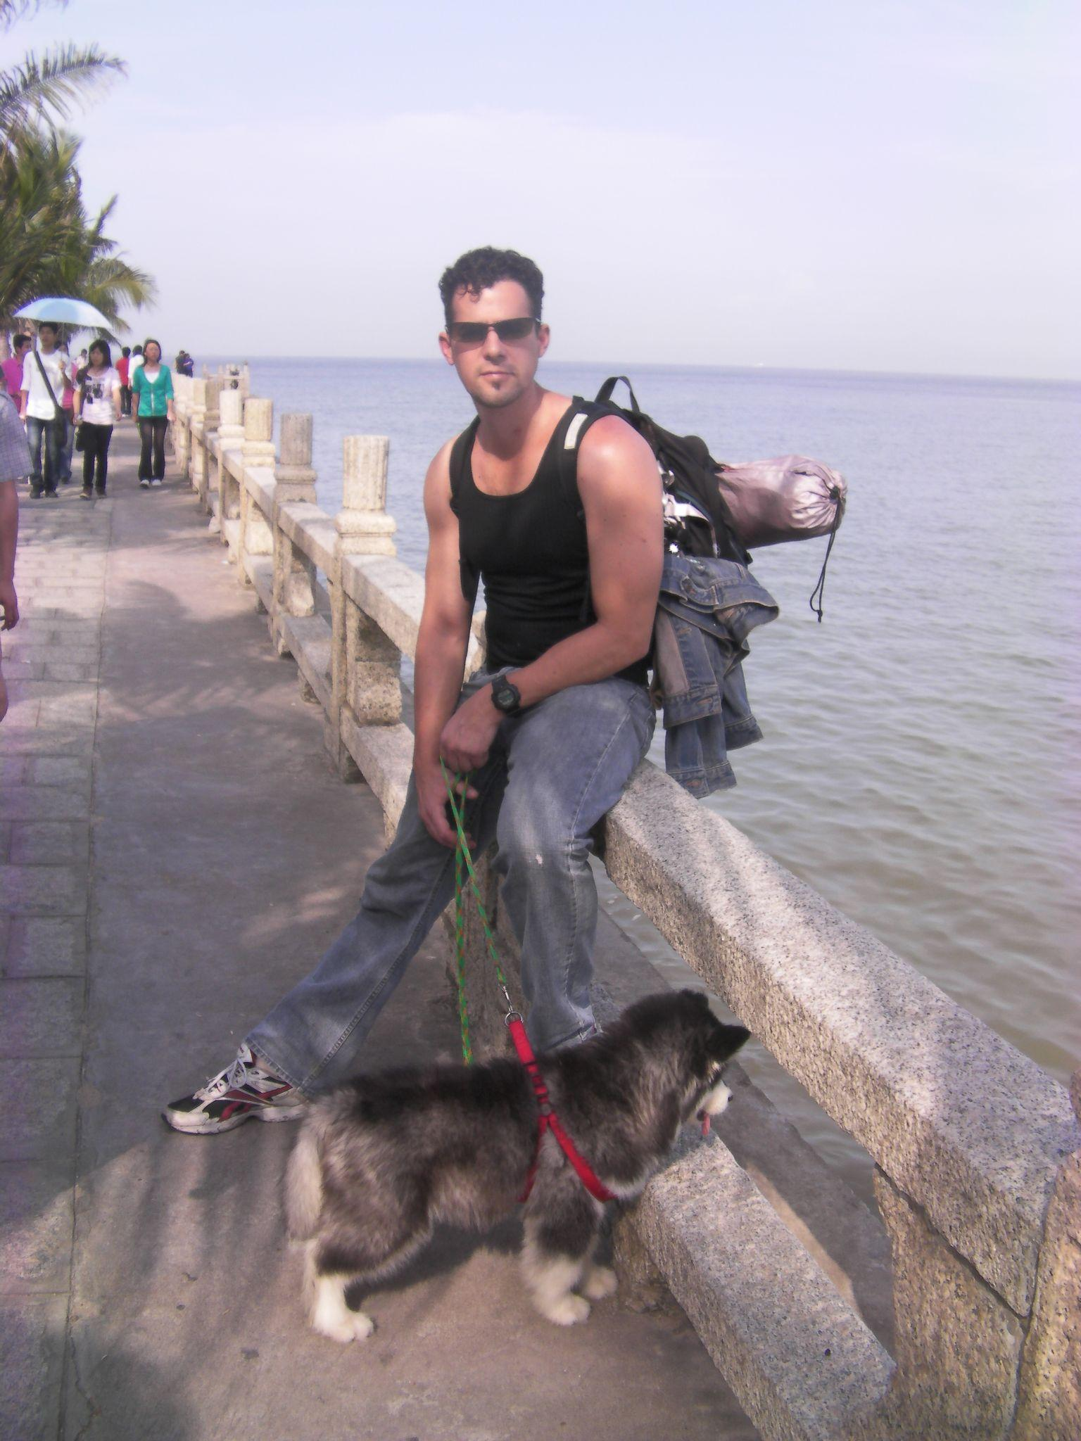
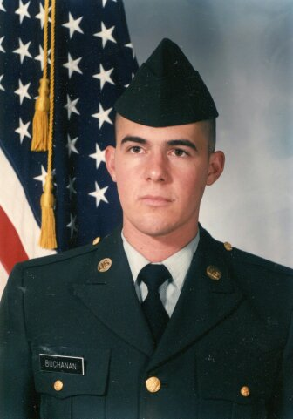
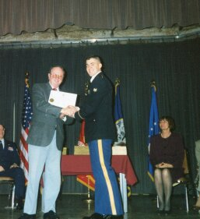
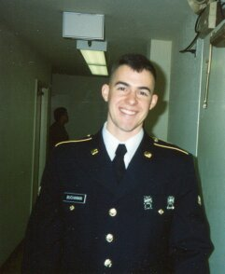
Student Images
The States of Soldiering
Disciplined soldier in Battle Dress Uniform, prepared to deploy for field.
Relaxed soldier on R & R with his family.
Class A soldier prepared for inspection.
Victorious soldier receiving award for outstanding performance.
Relieved soldier following rigorous training and prepared to revel with brothers.
1
2
3
4
5

Slide 3
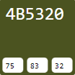
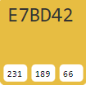
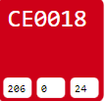

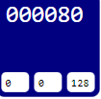
The Color Scheme
Powerful ideals and traditional themes
Army green represents the battle-ready soldier.
Gold stands for excellence and highest standards.
The red comes from the blood of a warrior and represents loyalty and strength.
White represents the purity, dignity and integrity of the outstanding gentleman trooper.
The blue on the starfield and worn by the soldier stands for glory, patriotism and honor.
1
2
3
4
5

Slide 4
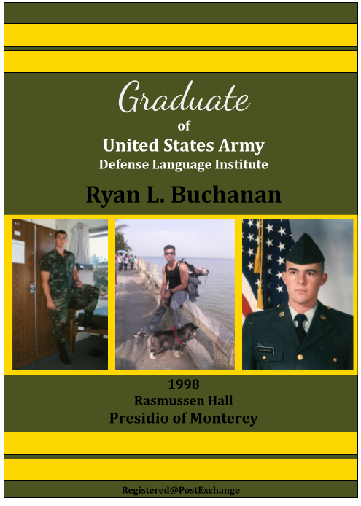
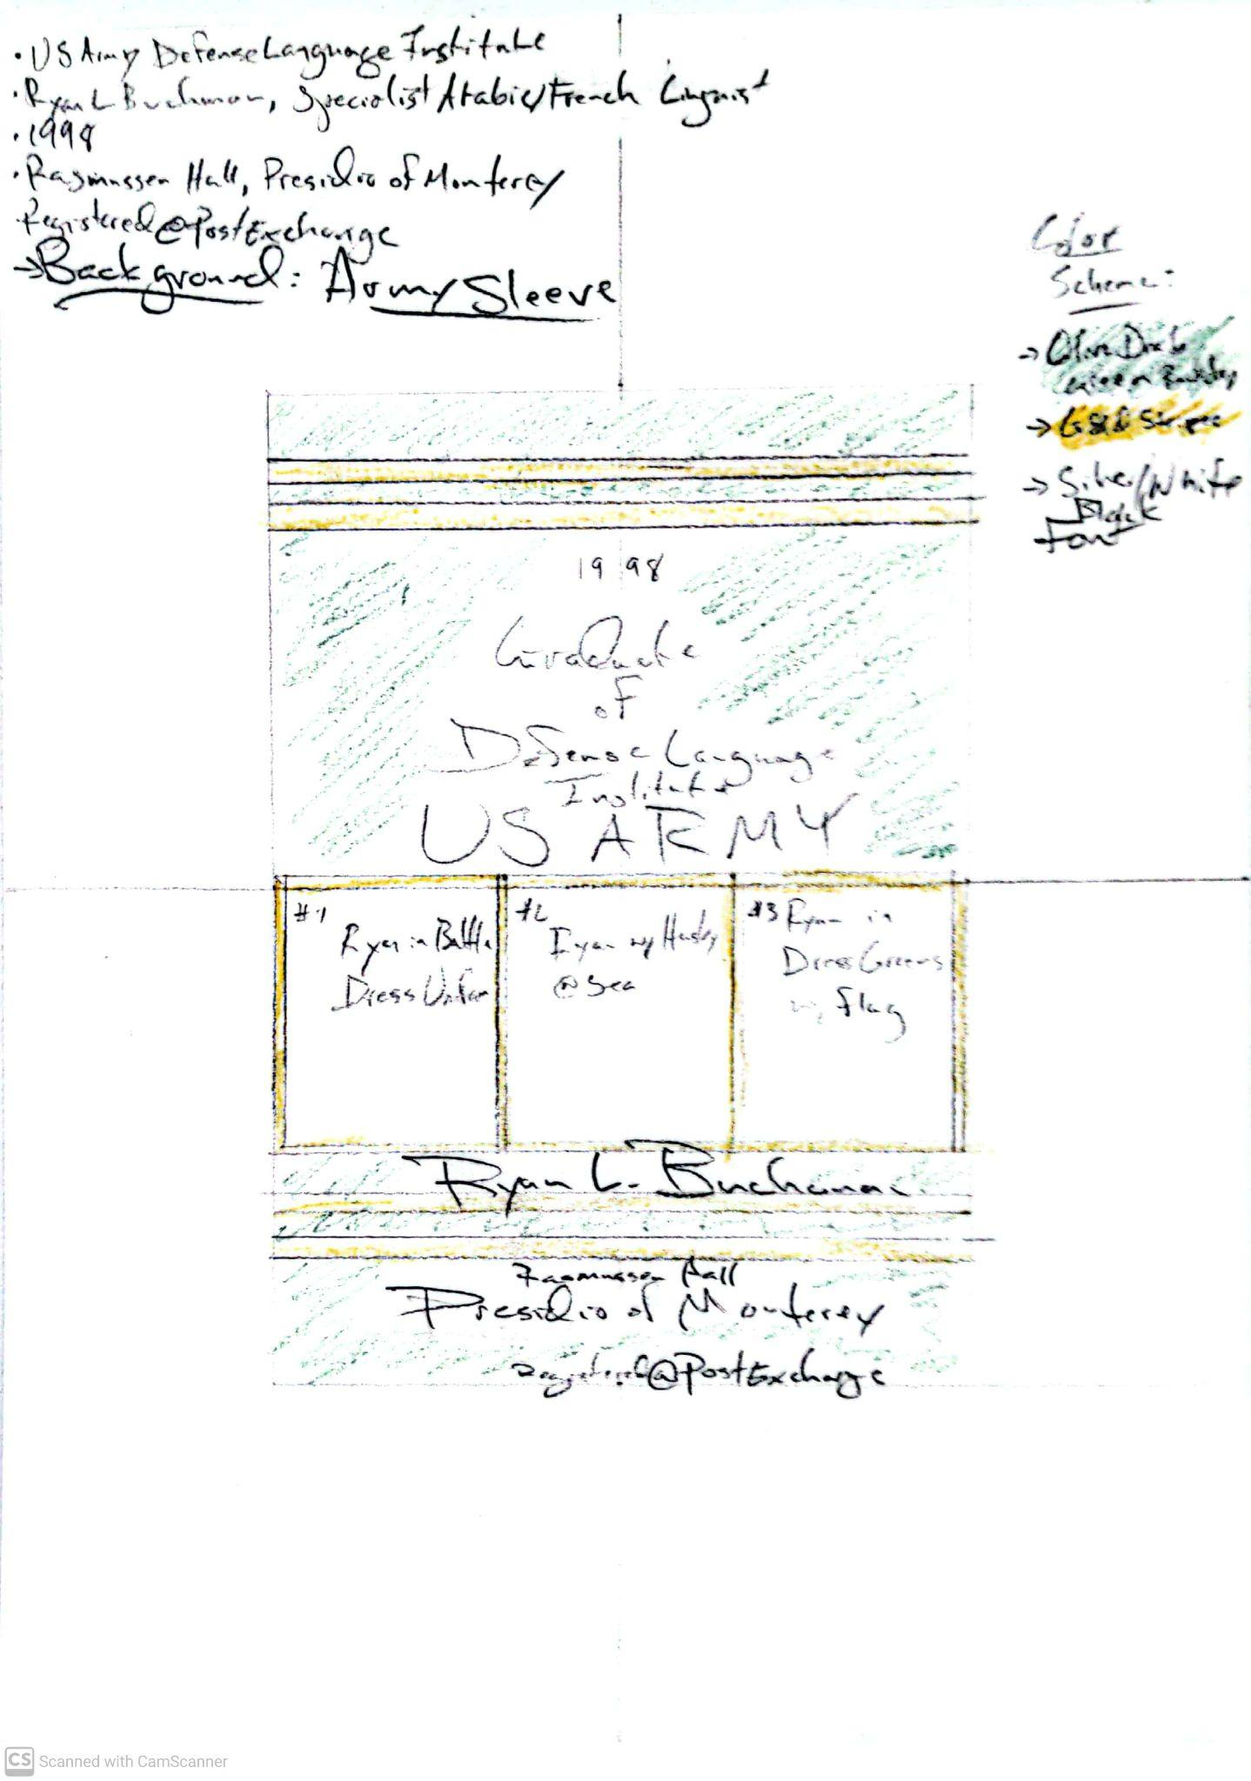
Army Sleeve Backdrop
Recognized Symbol of Achievement
Green and gold is for every US Army occasion.
Perhaps those receiving the invitation will be prior service.
It is a preview of all the proud men and women in uniform being awarded for their hard work.
The images chosen for the Army Sleeve theme represent toughness and discipline, like the green backdrop.
The gold framing the sleeve and the images is reminiscent of medals the trooper earns.

Slide 5
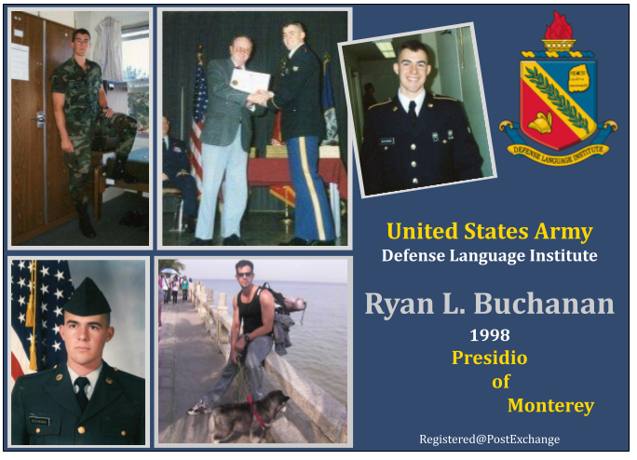
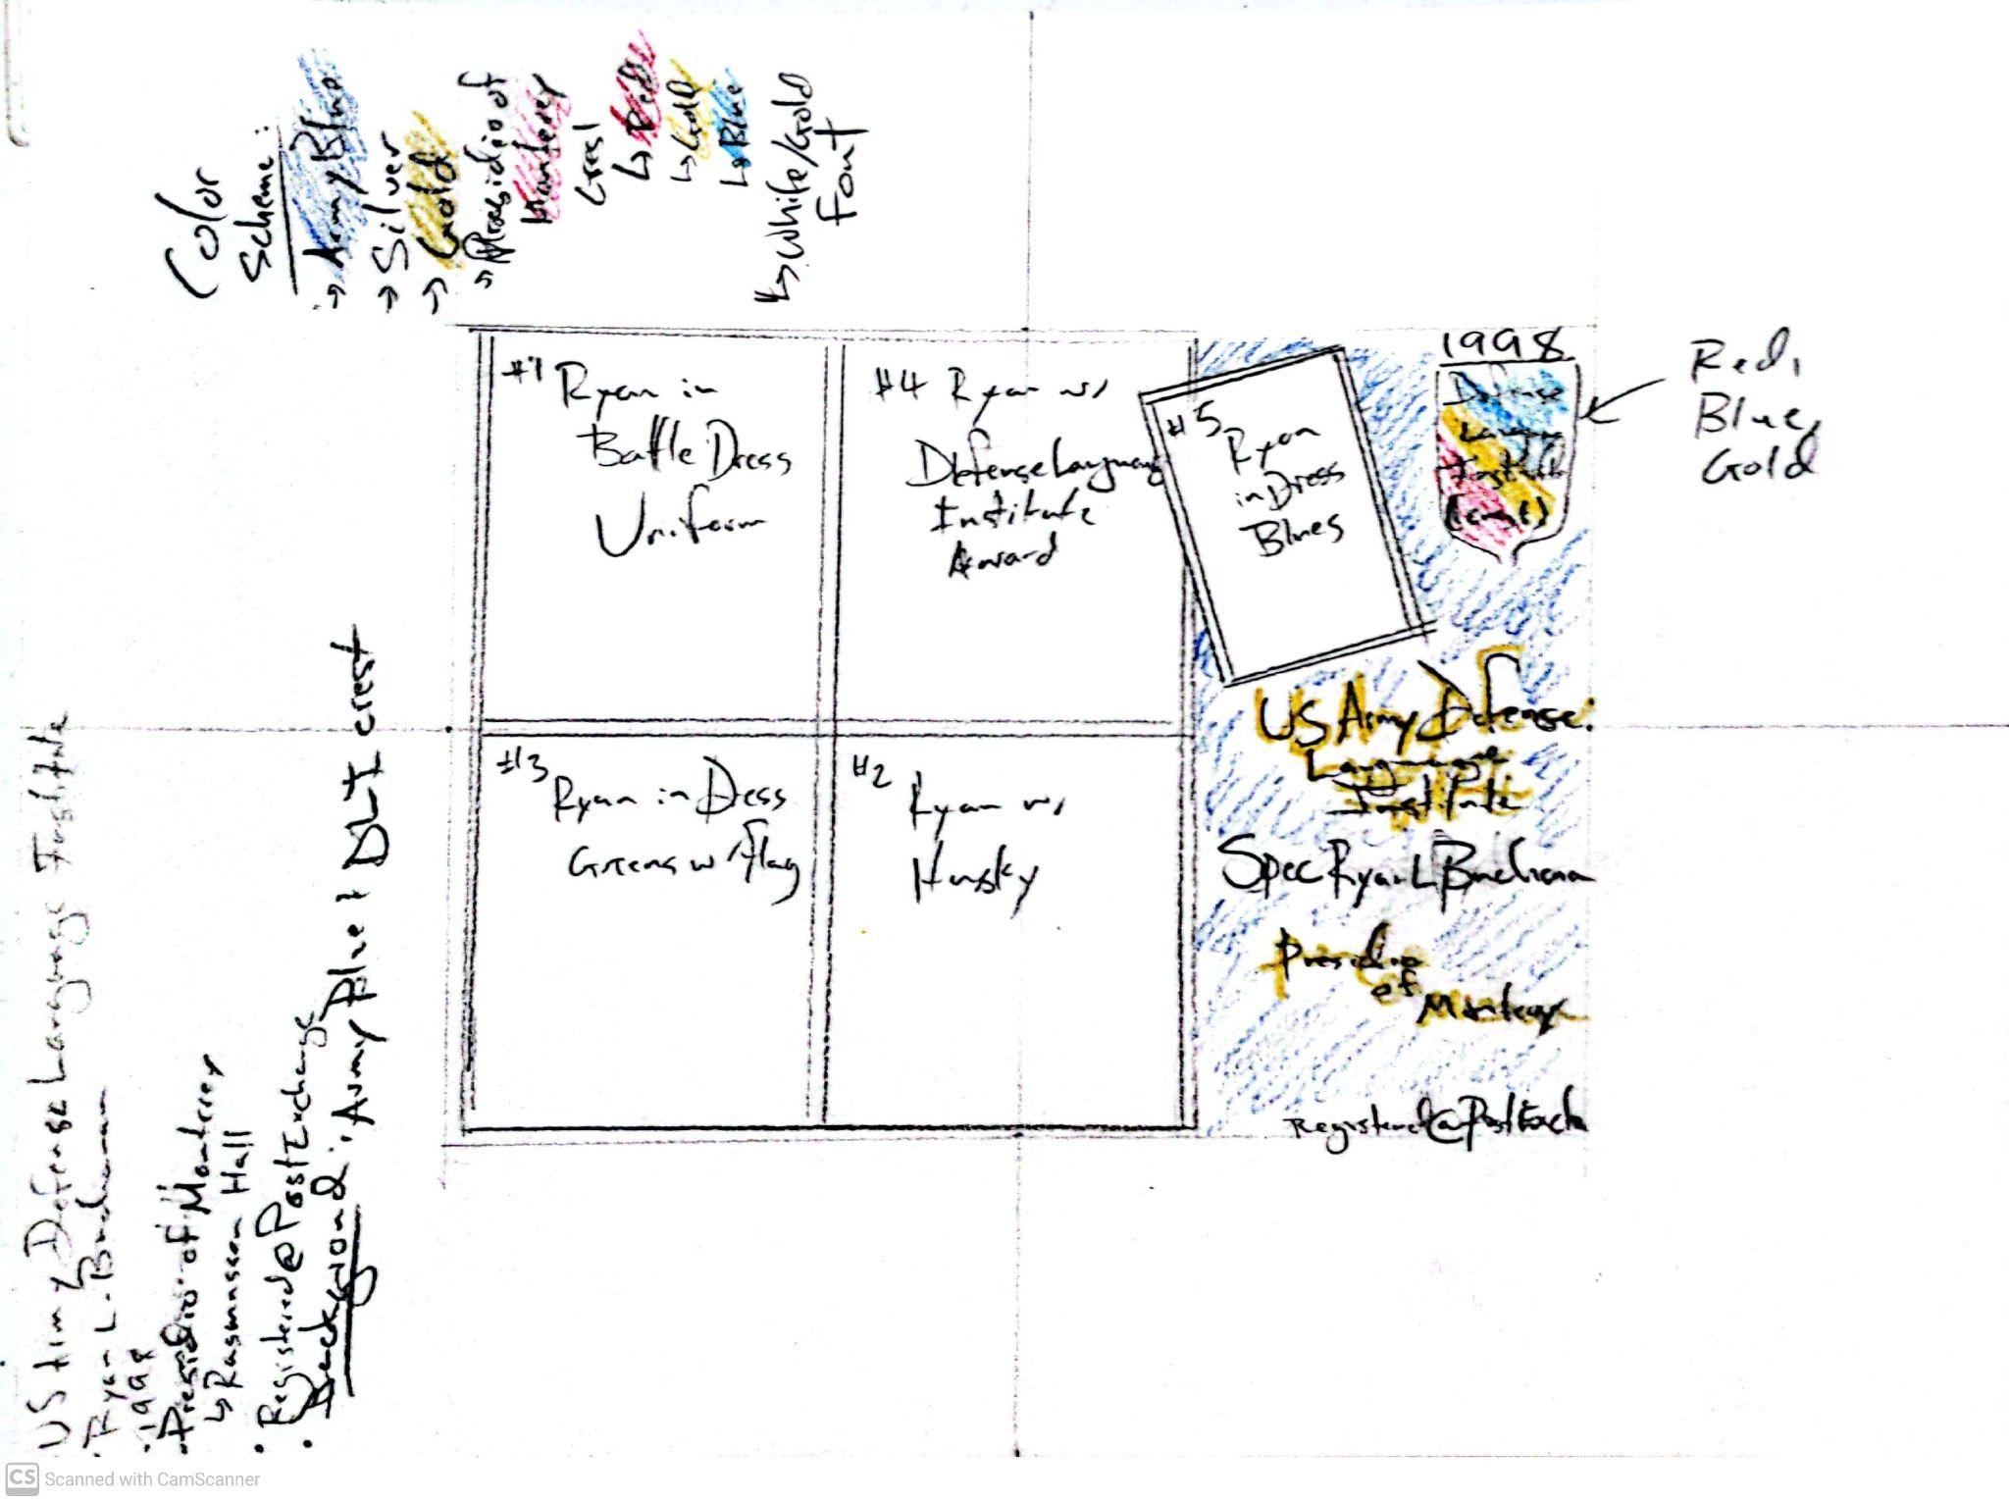
Defense Language Institute Crest
National Defense & Symbol of Intelligence
The dark blue of the uniform is for occasions of highest honor.
The DLI crest with it’s cap of Hermes and ancient tablet of intel demonstrate that the graduate has genuinely achieved excellence.
Highlighting the Defense Institute of Monterey brings out that the soldier is in the Intelligence Corp and has scored at the very top of his US Army entrance exams.
A central picture of the trooper receiving an award from the Provost of the DLI spotlights that this graduate is truly outstanding.

Slide 6
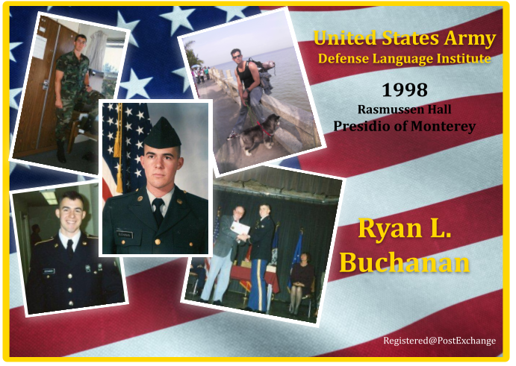
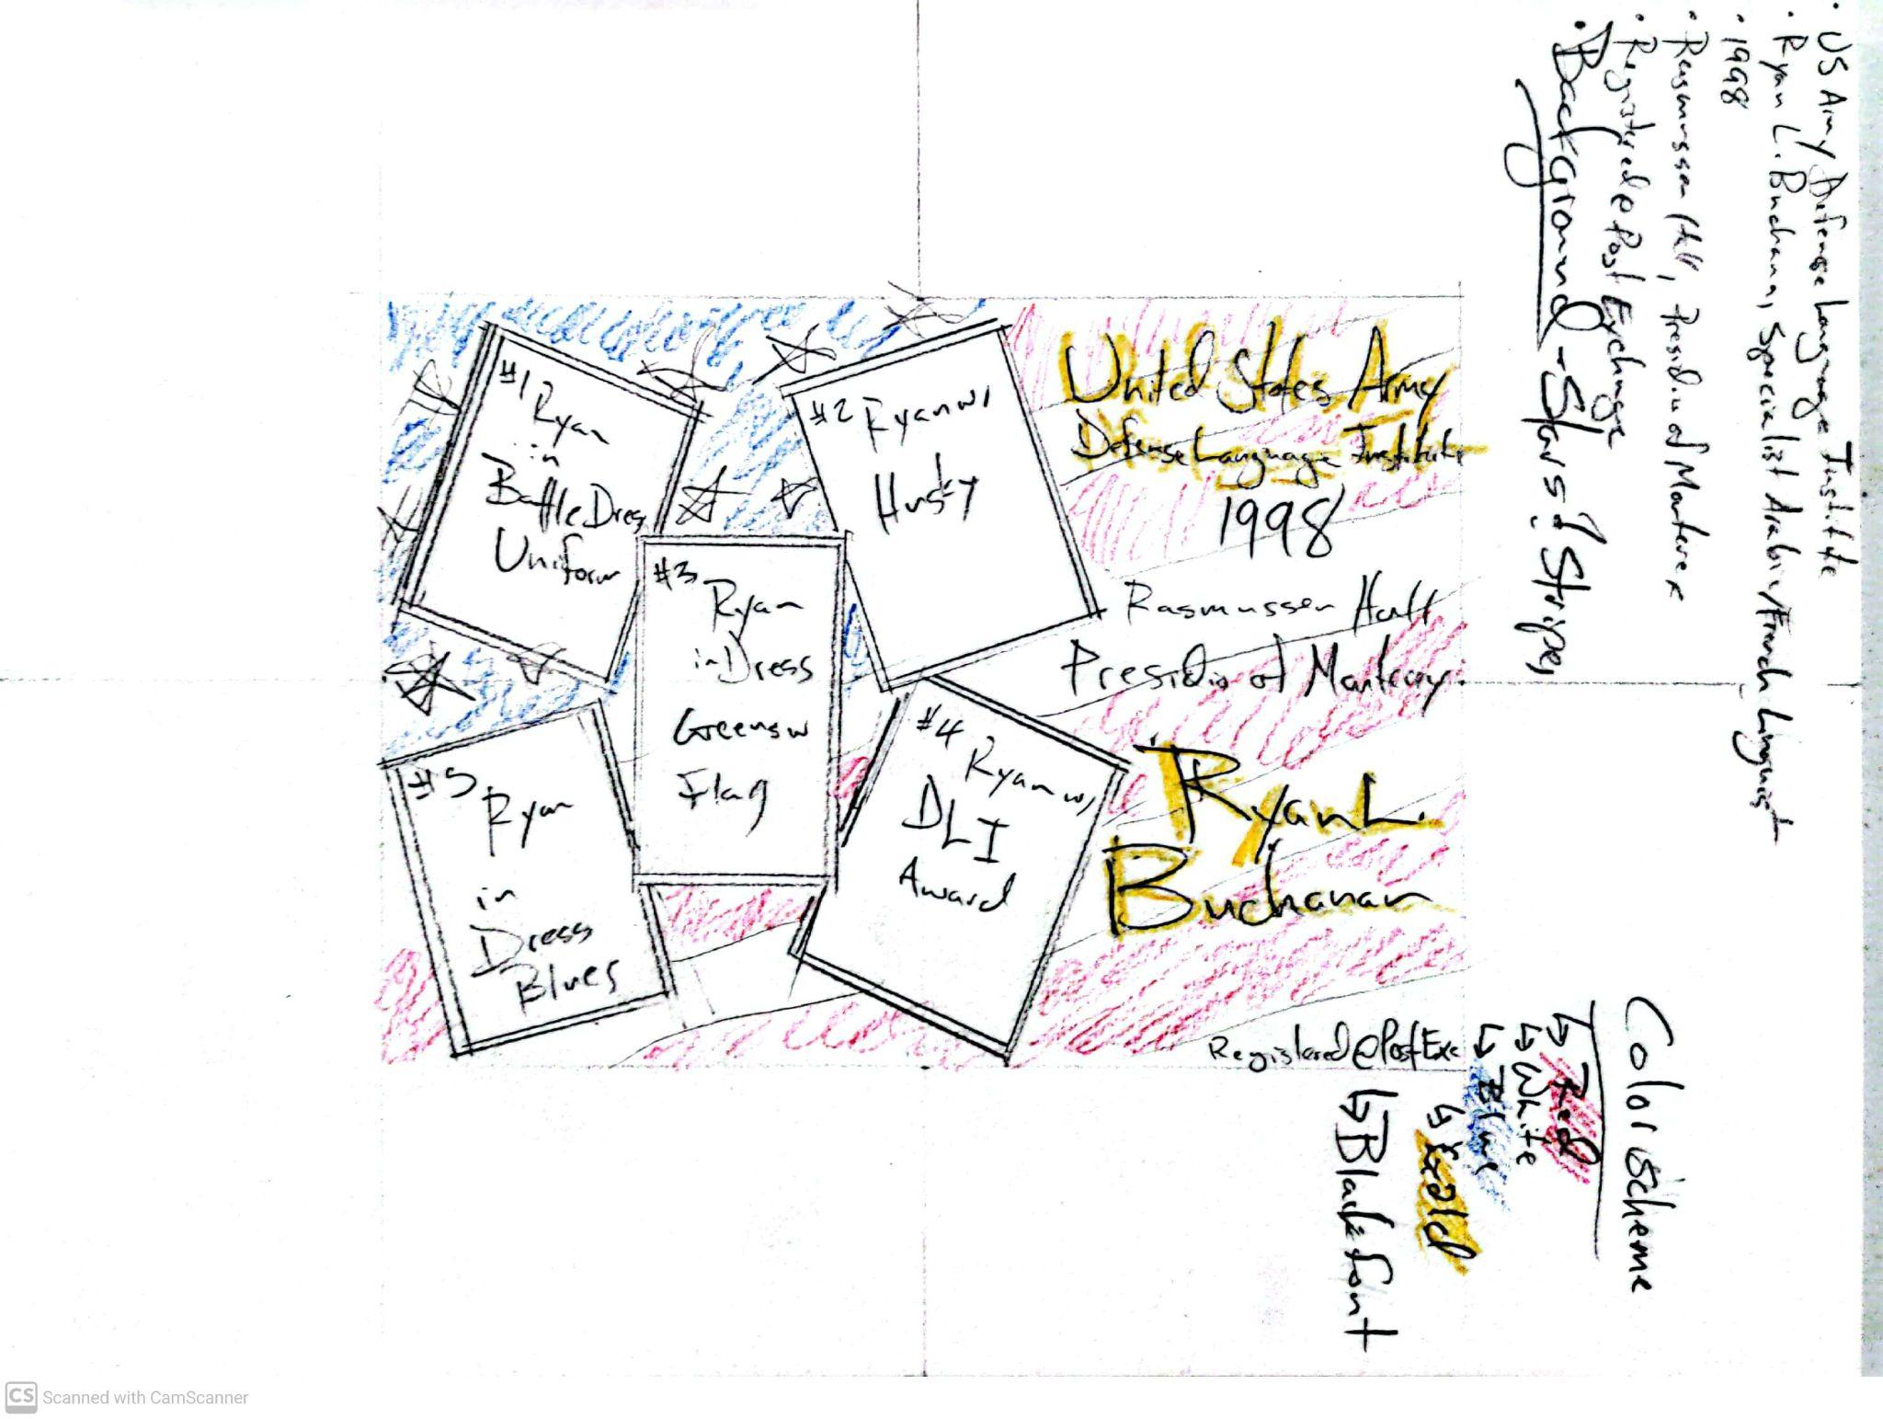
Stars and Stripes
God bless Old Glory
The United States flag is a superb backdrop to welcome the rise of a new soldier to defend his country.
Gold frames the entire invitation and represents excellence and highest standards, in the present and future.
Patriotism will swell in the hearts of those who receive and give them pride in their new graduate.
The central image of the collage, the trooper in Class A uniform, expresses dedication that will follow graduation.

